Slide 1
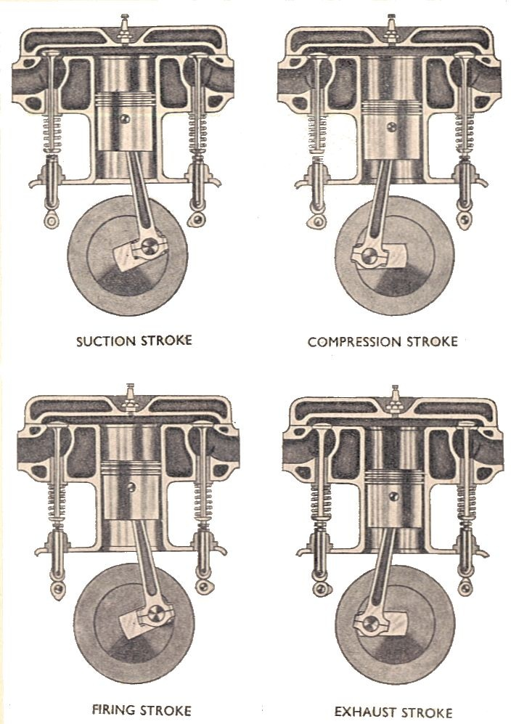
Manual of Driving and Maintenance for Mechanical Vehicles (Wheeled)

Slide 2
C
B
Pressure (Pa)
D
I
A
Volume (m³)

Slide 3
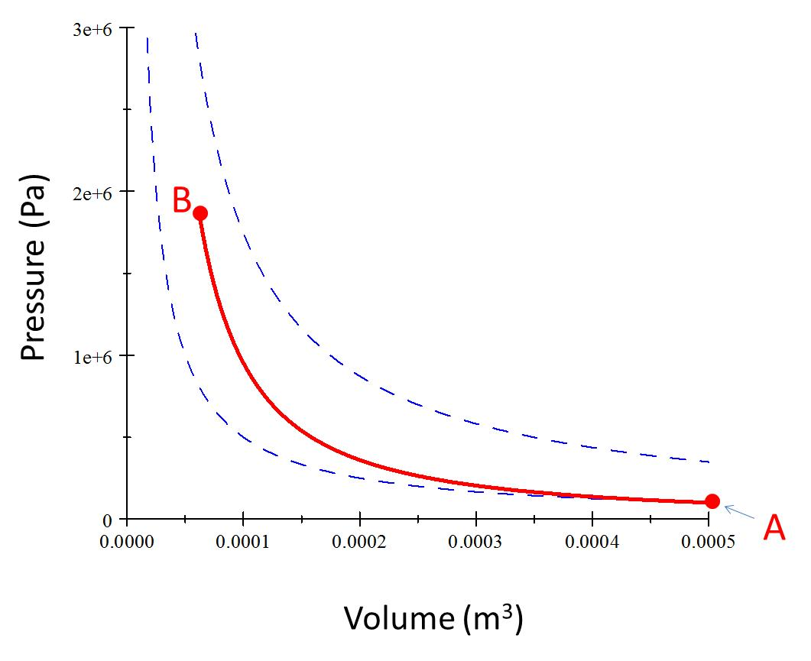
Process AB
Piston raises

Slide 4
C
B
Pressure (Pa)
Volume (m³)

Slide 5
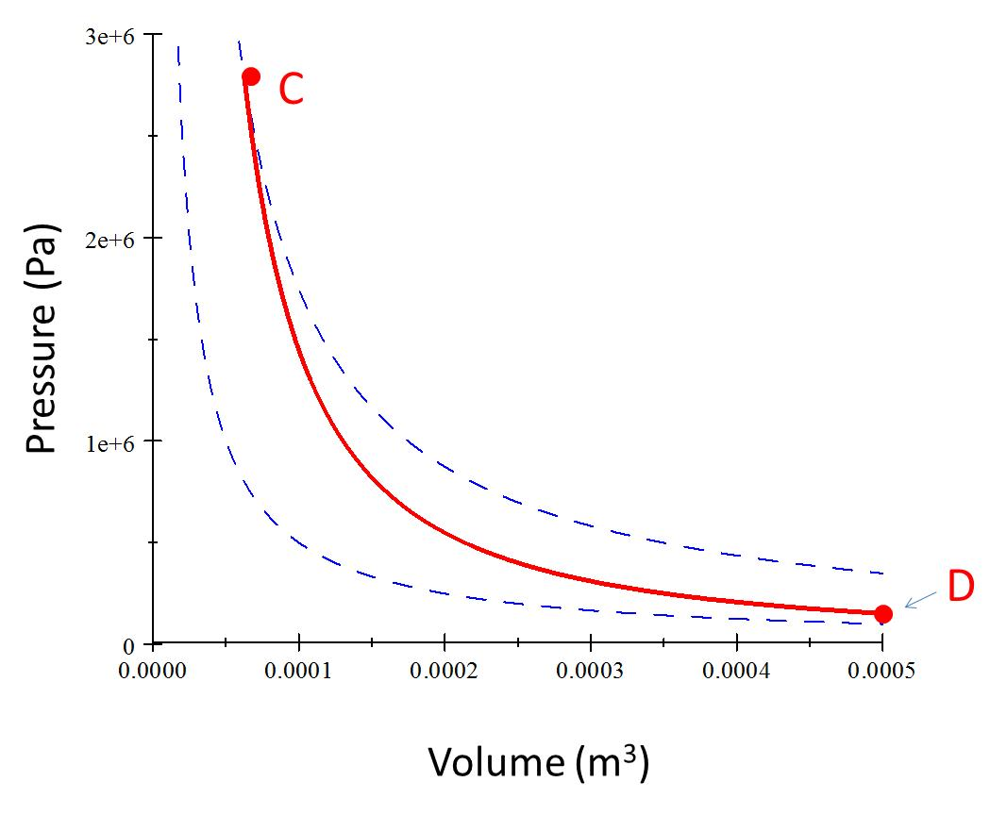
Process CD (Power Stroke)
Piston Lowers

Slide 6
Pressure (Pa)
D
A
Volume (m³)

Slide 7
Process AI
Exhaust valve opens
Piston rises

Slide 8
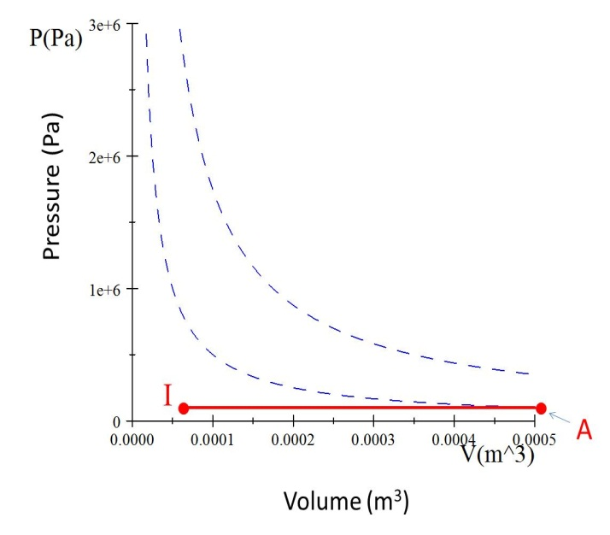
Process IA
Intake valve opens
Piston Lowers

Slide 9
C
Q_{h}
B
Pressure (Pa)
Work Required
Useful Work Out
D
I
Q_{c}
A
Volume (m³)

Slide 10
B
Pressure (Pa)
A
Volume (m³)

Slide 11
C
Pressure (Pa)
D
Volume (m³)

Slide 12
Pressure (Pa)
I
A
Volume (m³)

